Slide 1
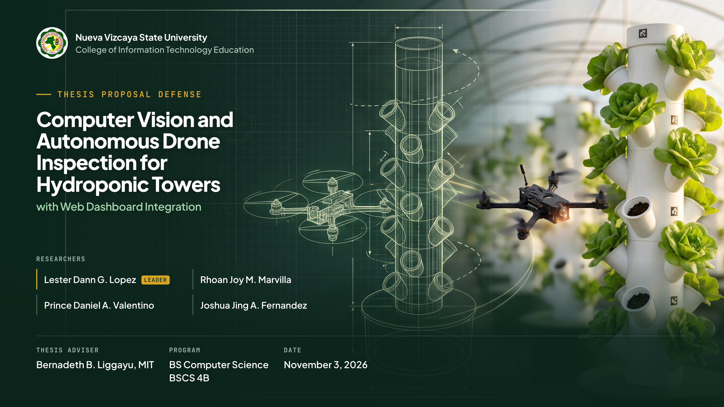
Notes:
Good [morning / afternoon] to our panel, to our adviser, Bernadeth B. Liggayu, and to everyone here. I am Lester Dann Lopez, with Rhoan Joy Marvilla, Prince Daniel Valentino, and Joshua Jing Fernandez, from BSCS 4B. Today we present "Computer Vision and Autonomous Drone Inspection for Hydroponic Towers with Web Dashboard Integration."

Slide 2
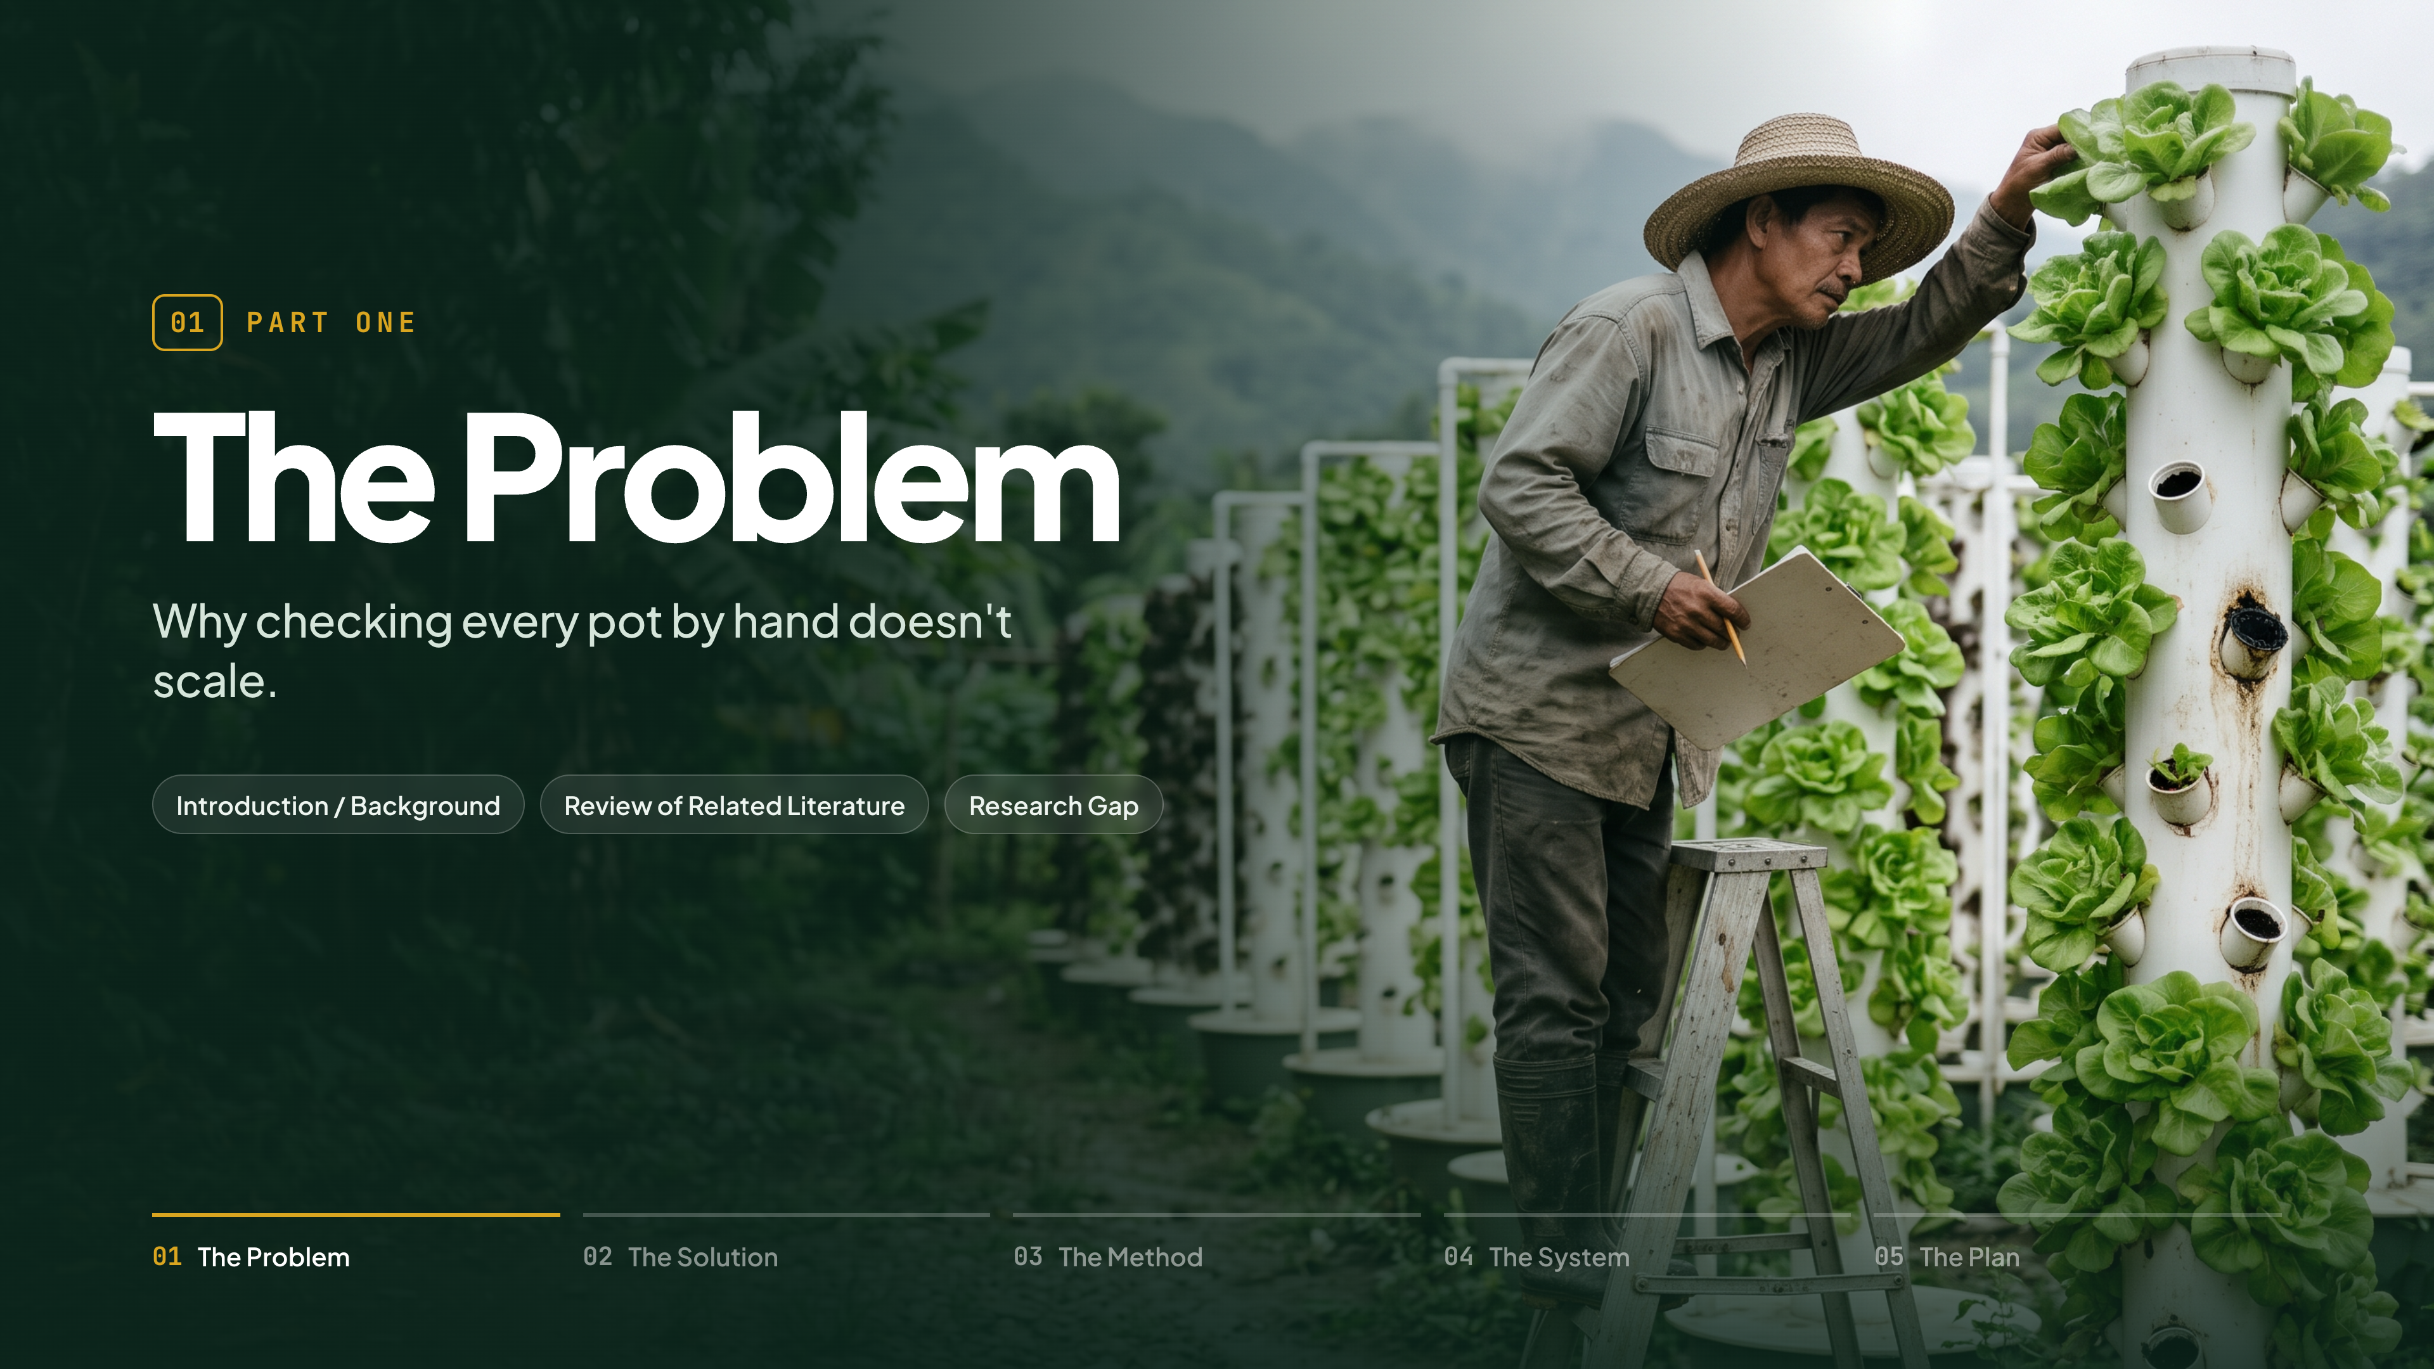
Notes:
(No lines.)

Slide 3
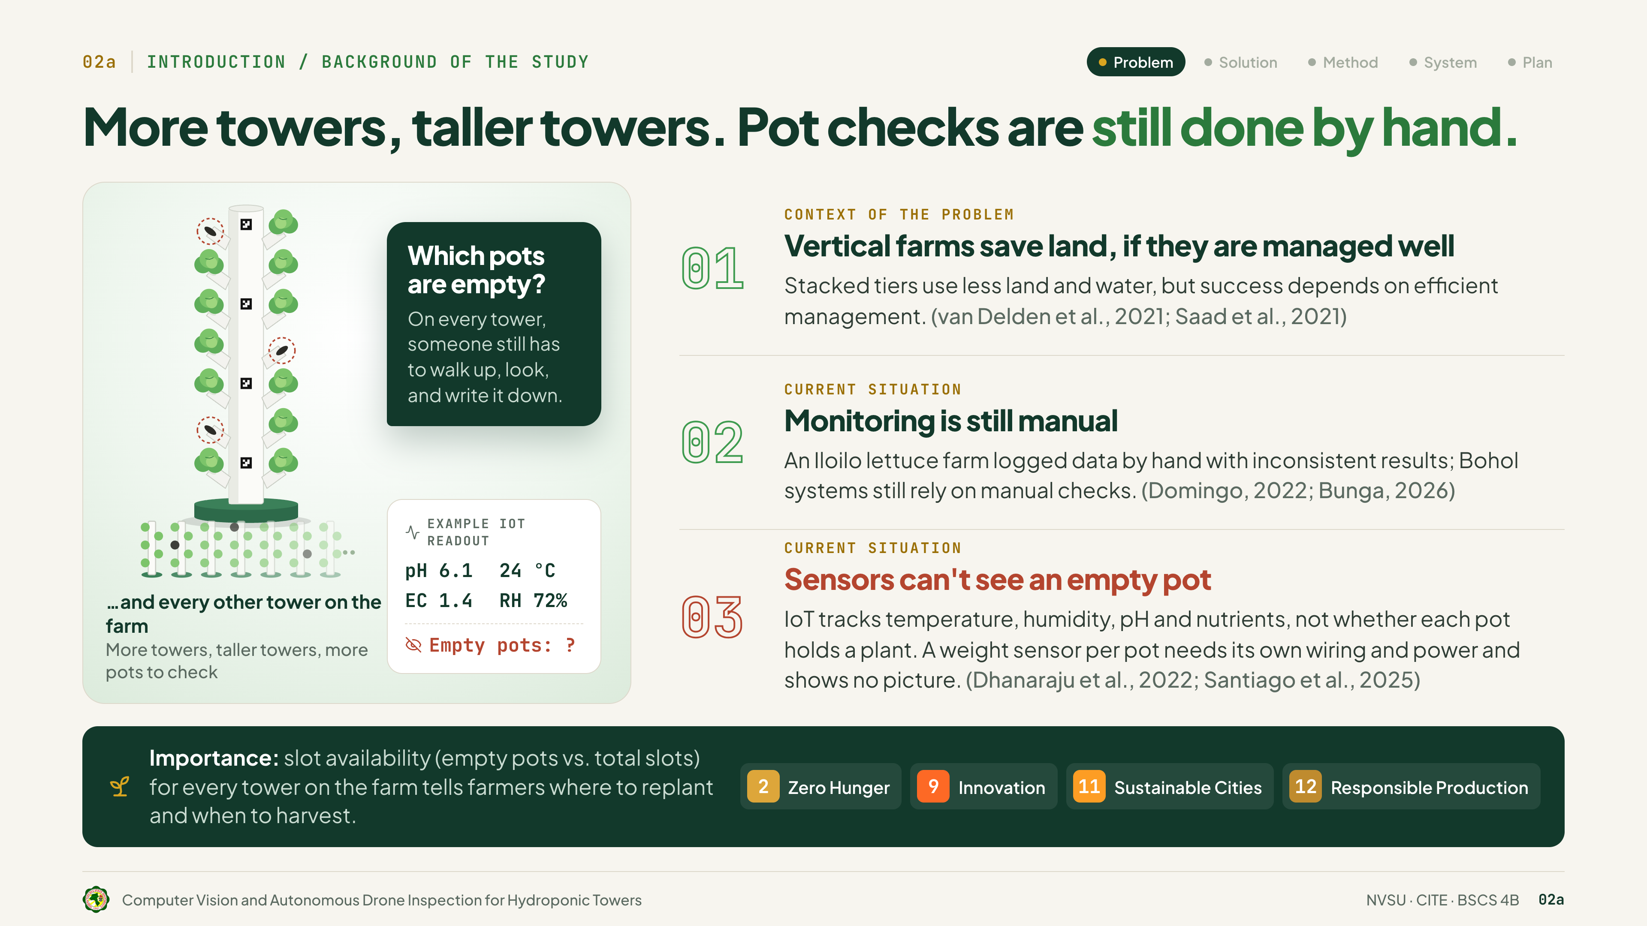
Notes:
Vertical farms save land, but only if they are managed well, according to van Delden and Saad. Today, monitoring is still manual, as Domingo and Bunga show for farms in Iloilo and Bohol. And sensors can't see an empty pot. IoT, in studies by Dhanaraju and Santiago, measures pH and nutrients, and a weight sensor per pot needs its own wiring and shows no picture.
So on every tower, and every other tower on the farm, someone still walks up and checks by hand. Knowing the slot availability tells farmers where to replant and when to harvest.

Slide 4
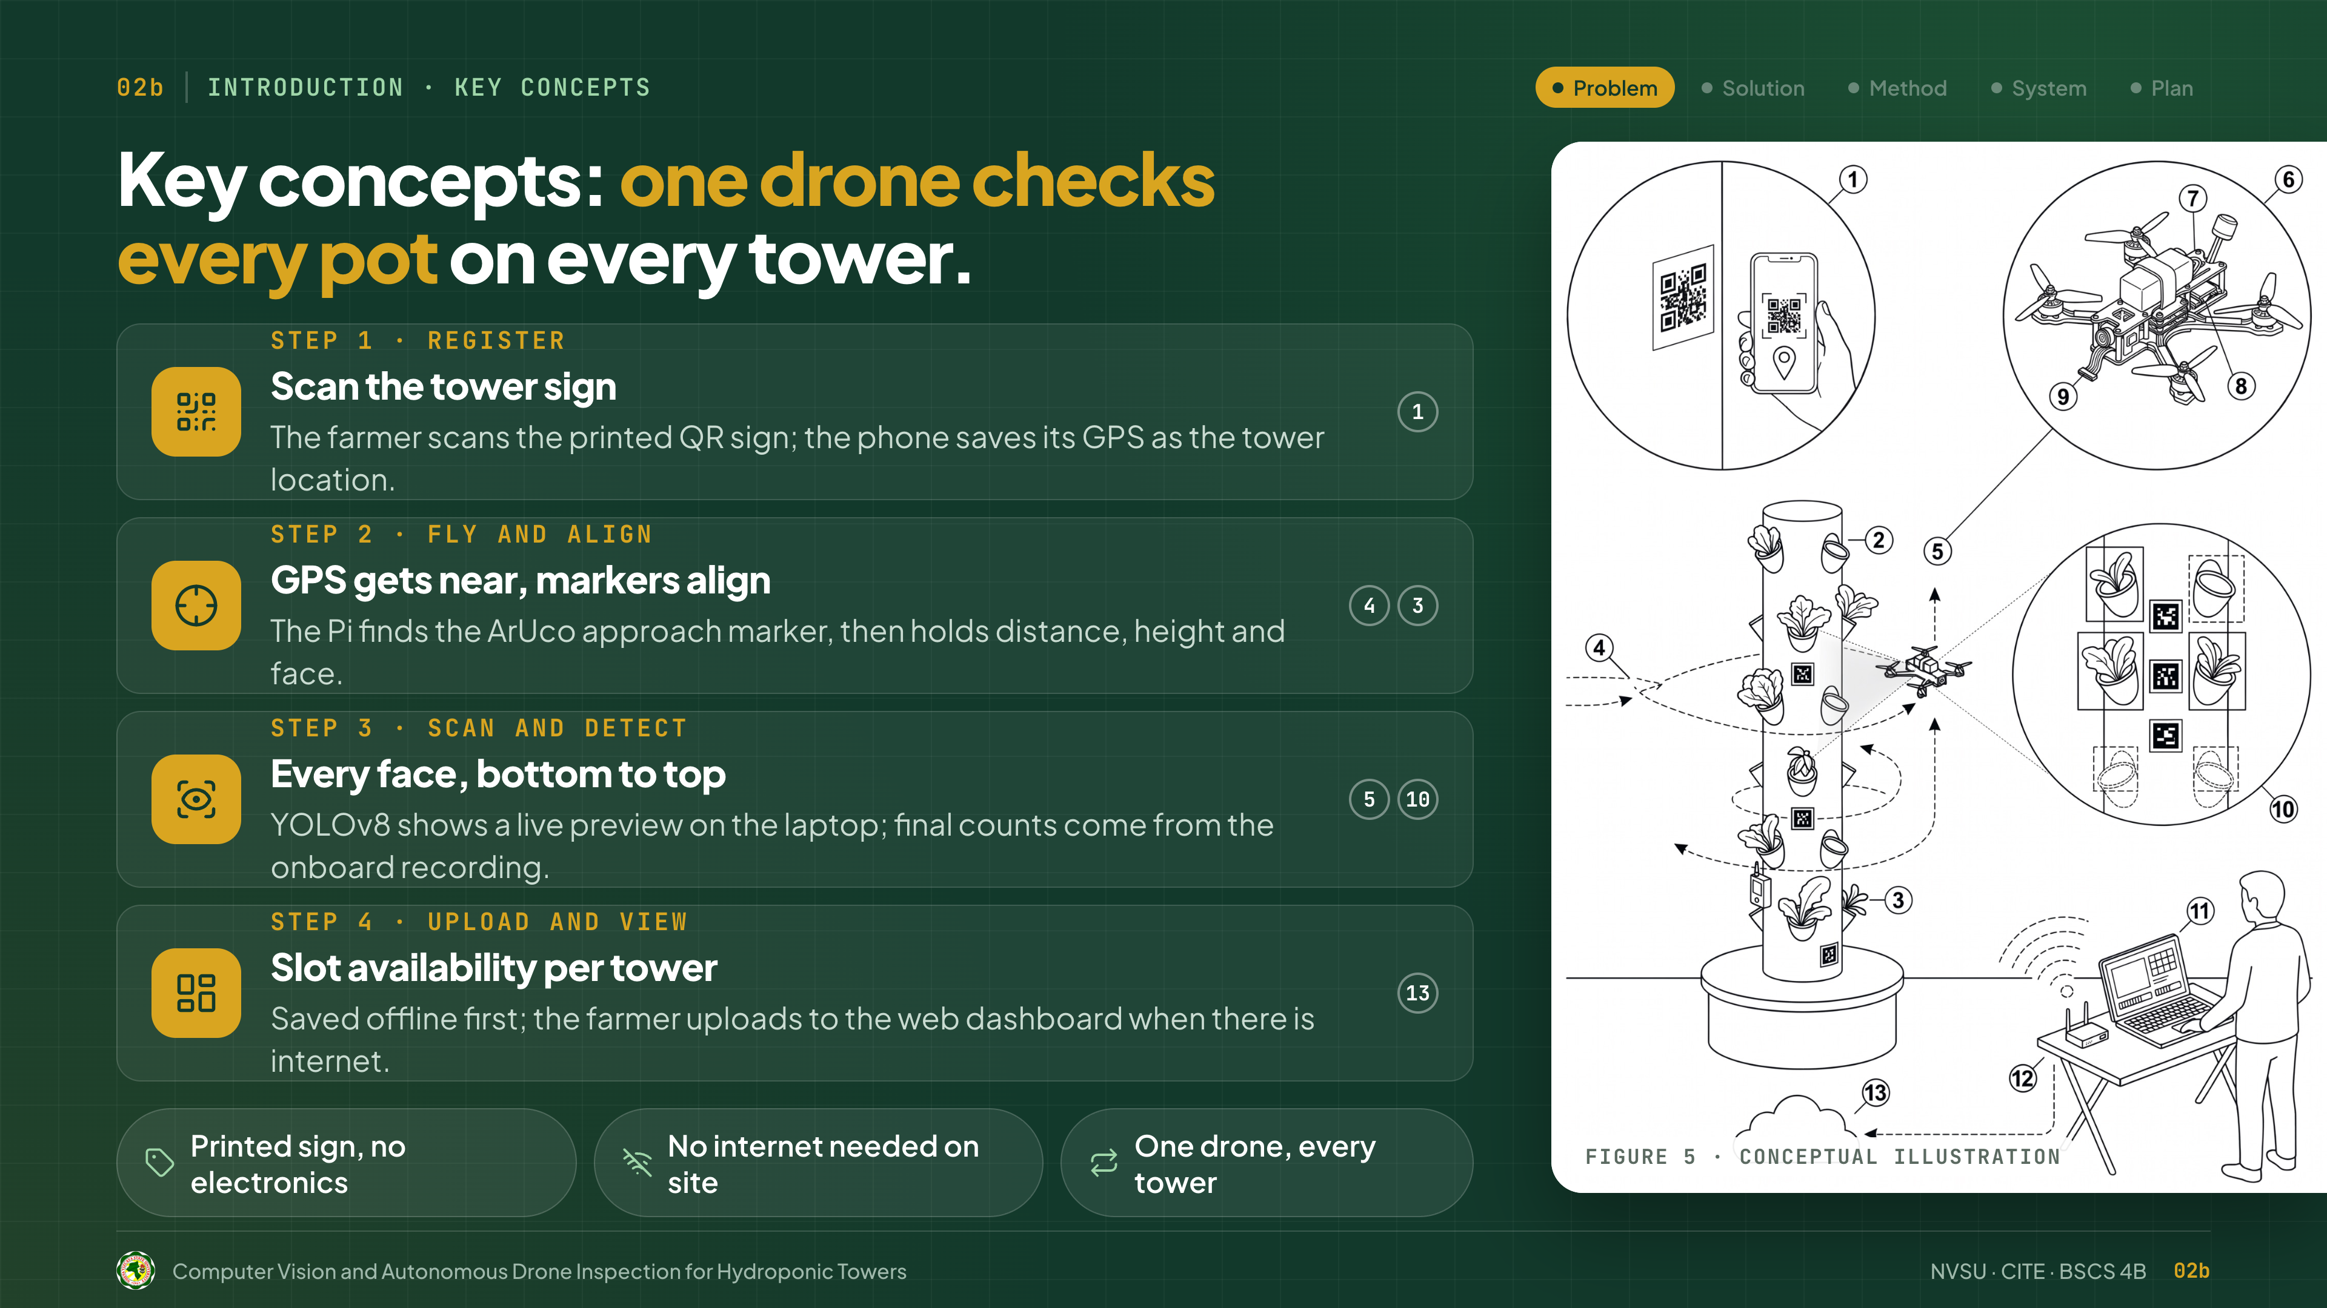
Notes:
Our key concept: one drone checks every pot on every tower, in four steps.
Step 1, register: the farmer scans the tower's QR sign, and the phone saves its GPS. Step 2, fly and align: GPS gets the drone near, and the ArUco markers hold its position. Step 3, scan and detect: the drone scans every face, and YOLOv8 counts lettuce and empty pots. Step 4, upload and view: results are saved offline, then uploaded to the dashboard.

Slide 5
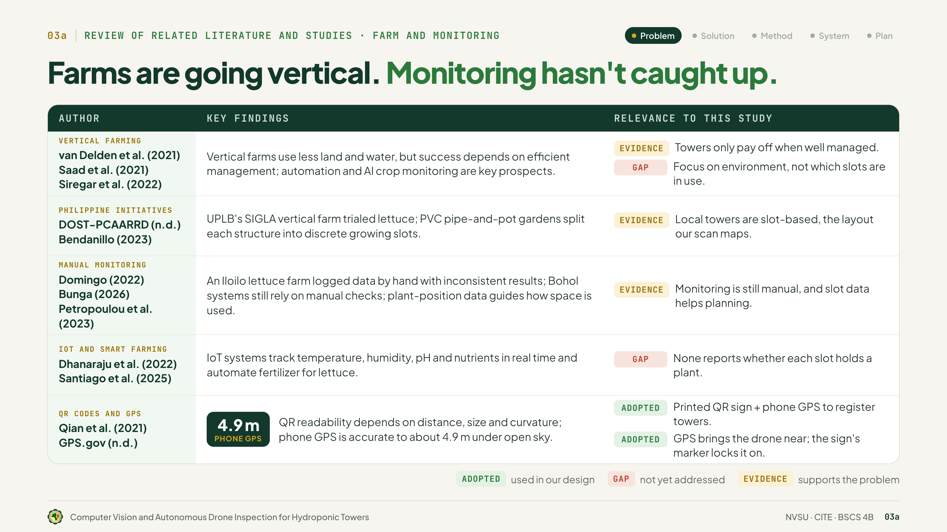
Notes:
Thank you. We reviewed 38 sources.
Van Delden, Saad and Siregar found vertical farms save land and water, but only if they are managed well. They don't track which slots are being used.
DOST-PCAARRD and Bendanillo show local towers are built in separate slots, the same layout our drone scans.
Domingo and Bunga found farms in Iloilo and Bohol still check by hand, and Petropoulou showed that knowing where the plants are helps plan the space.
Dhanaraju and Santiago's sensor systems track pH and nutrients, but never check if a slot has a plant.
Qian found phones read QR codes reliably, and GPS.gov says phone GPS can be off by about 4.9 meters. So we use the QR code and phone GPS to register towers, and the marker on the sign for the final alignment.

Slide 6
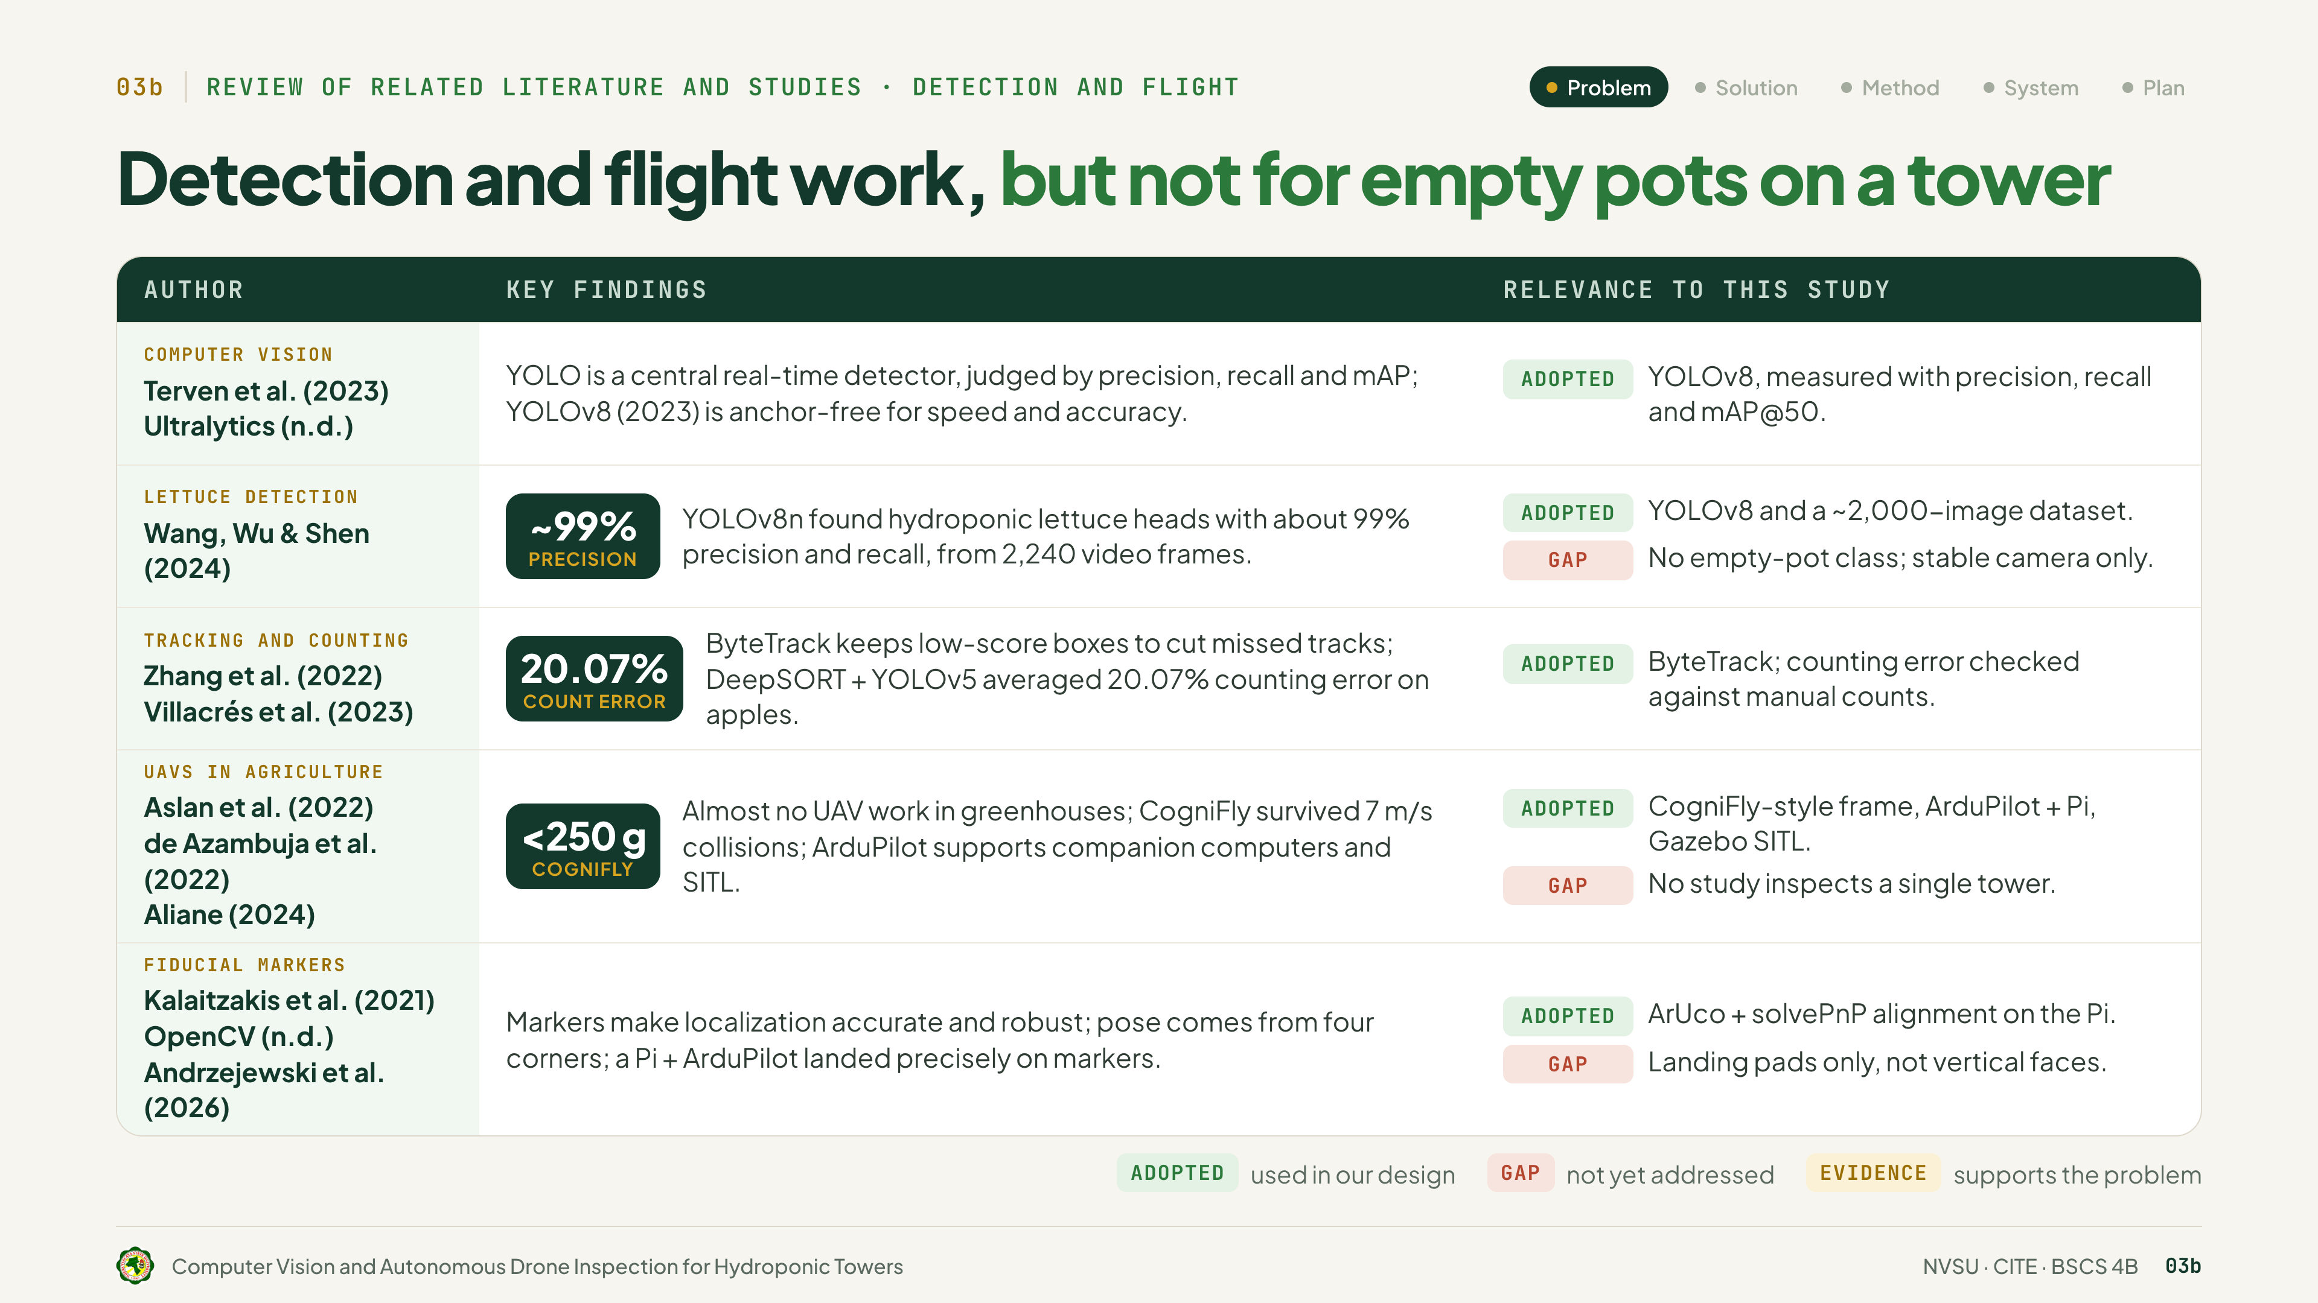
Notes:
Terven and Ultralytics describe YOLO as a fast AI that finds objects in video. Wang, Wu and Shen used YOLOv8 on lettuce and scored about 99 percent. So we use YOLOv8, but they never taught it to find empty pots.
Zhang's ByteTrack makes sure each plant is counted only once. Still, Villacrés found video counts can be off by about 20 percent, so we compare ours with a count done by hand.
Aslan found drones are rarely flown close to plants. De Azambuja's CogniFly, under 250 grams, showed a light drone is safer, and Aliane shows ArduPilot lets us test in simulation first.
Kalaitzakis, OpenCV and Andrzejewski show printed markers help a drone position itself exactly, but only for landing, never beside a tower.

Slide 7
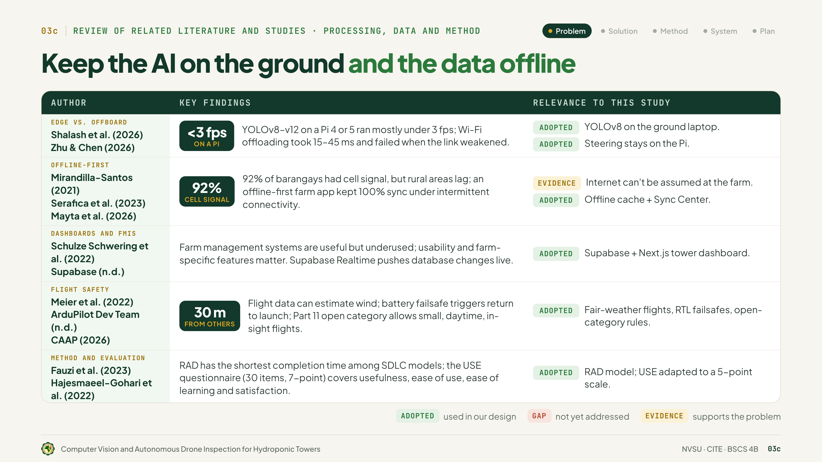
Notes:
Shalash found AI runs too slowly on a Raspberry Pi, and Zhu and Chen found Wi-Fi can lag. So the laptop runs the AI, and the drone steers itself.
Mirandilla-Santos and Serafica show rural internet is unreliable, and Mayta's farm app worked offline and synced later. Ours does the same.
Schulze Schwering and Supabase shaped our dashboard; Meier, ArduPilot and CAAP, our safety rules; and Fauzi and Hajesmaeel-Gohari, our RAD method and survey.

Slide 8
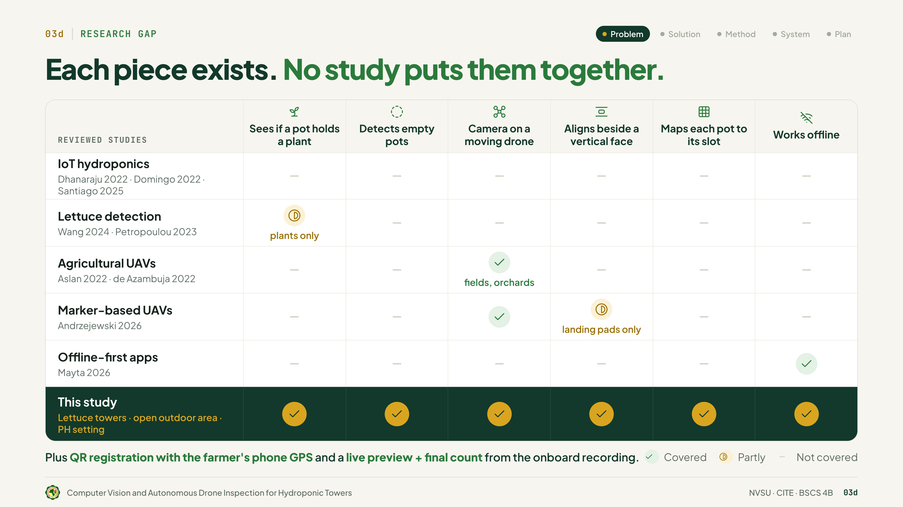
Notes:
Each piece exists, but no study puts them together. Dhanaraju, Domingo and Santiago don't look at the pots. Wang and Petropoulou find plants, not empty pots. Aslan and de Azambuja fly over fields, not beside a tower. Andrzejewski uses markers only to land. Mayta's app works offline, but does nothing more. No study we reviewed does all of this. Ours does.

Slide 9
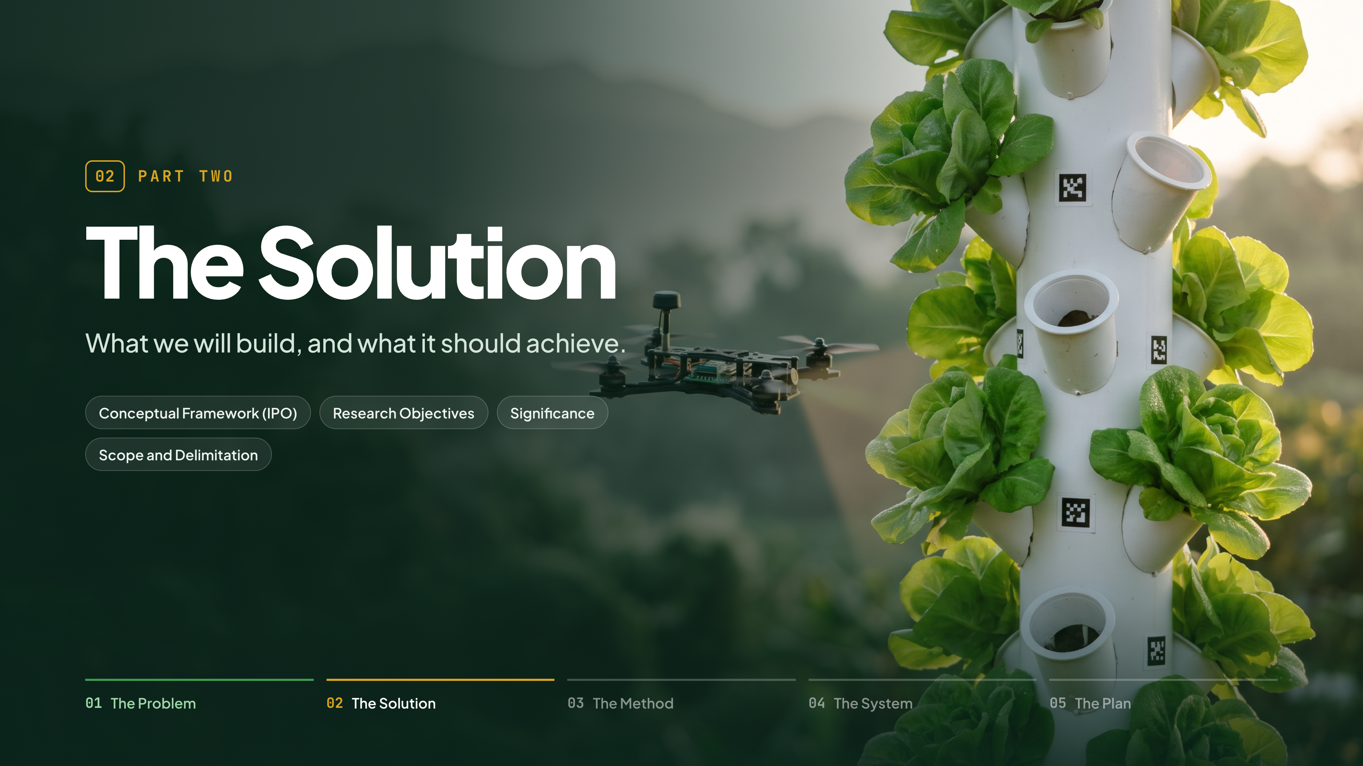
Notes:
(No lines.)

Slide 10
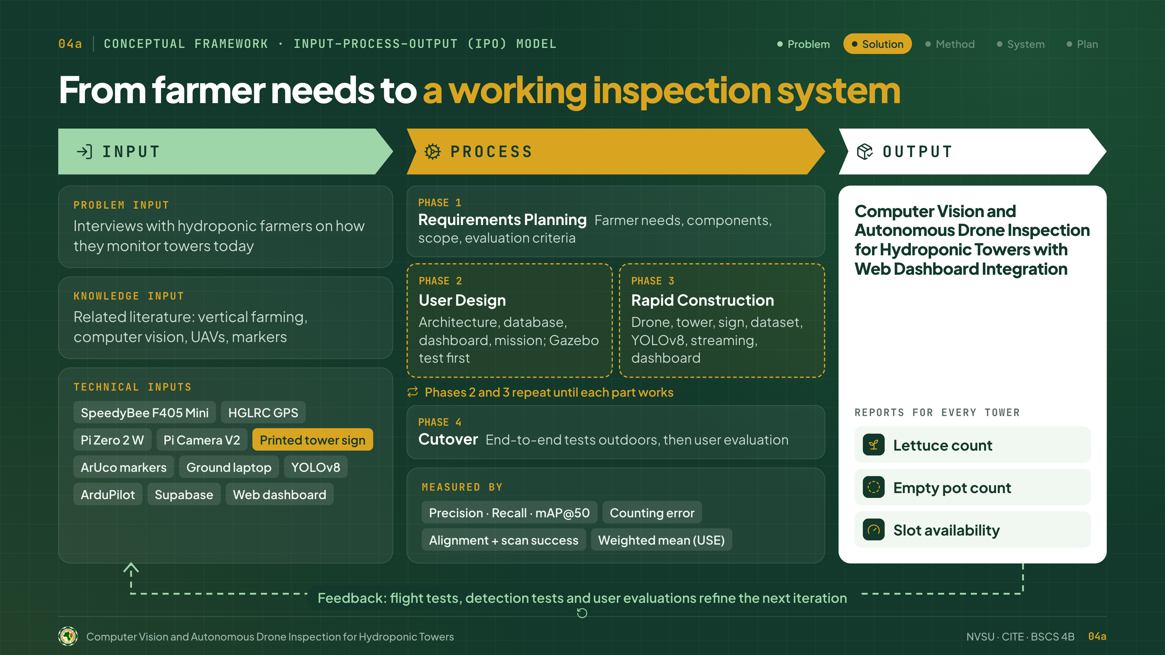
Notes:
Our framework follows the Input–Process–Output model, from farmer needs to a working inspection system.
The input has three parts. The problem input comes from interviews with farmers on how they monitor towers today. The knowledge input comes from the literature on vertical farming, computer vision, drones and markers. The technical inputs are our hardware and software: the SpeedyBee flight controller, GPS, Raspberry Pi and camera, the printed tower sign, ArUco markers, the ground laptop, YOLOv8, ArduPilot, Supabase and the web dashboard.
The process follows RAD in four phases. Phase 1, Requirements Planning: we gather farmer needs and choose the components, scope and evaluation criteria. Phase 2, User Design: we design the system, database, dashboard and drone mission, and test it in a Gazebo simulation first. Phase 3, Rapid Construction: we build the drone, tower, sign, dataset, YOLOv8 model, streaming and dashboard. Phases 2 and 3 repeat until each part works. Phase 4, Cutover: we test the whole system outdoors, then run the user evaluation.
We measure it with precision, recall and mAP@50, counting error, alignment and scan success, and the weighted mean of the USE survey.
The output is our system, which reports the lettuce count, empty pot count and slot availability for every tower. And feedback from the tests and evaluations goes back into the next cycle.

Slide 11
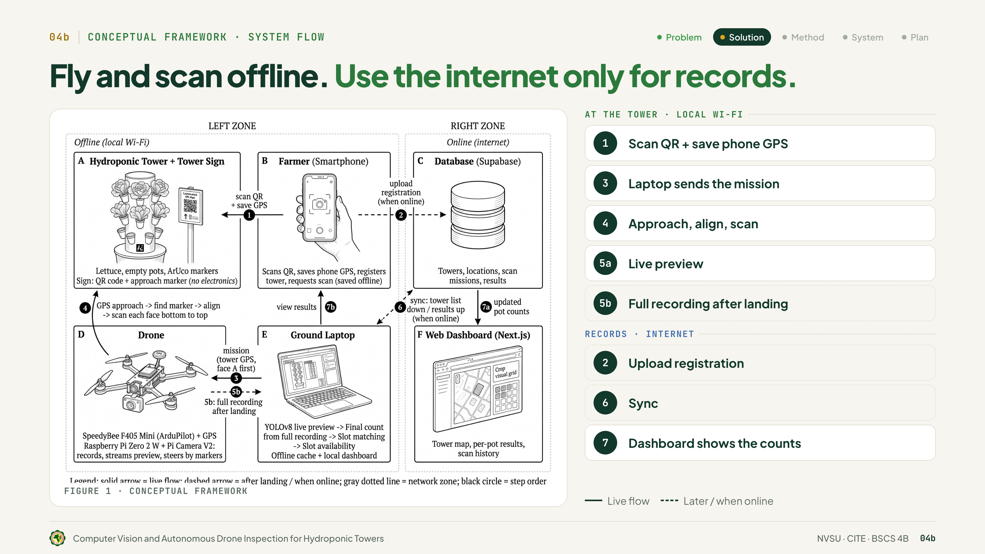
Notes:
Figure 1 shows the full flow. The left zone runs offline, on the farm's Wi-Fi; the right zone needs internet. The parts are A, the tower and its sign; B, the farmer's phone; C, the Supabase database; D, the drone; E, the ground laptop; and F, the web dashboard.
Step 1, the farmer scans the tower's QR sign, and the phone saves its GPS. Step 2, it uploads when online. Step 3, the laptop sends the mission. Step 4, the drone flies there by GPS, locks on to the marker, and scans each face. Step 5a, a live preview streams to the laptop; 5b, after landing, the full recording gives the final count for each pot. Steps 6 and 7, the laptop syncs, and the farmer sees the results.
So the scan needs only local Wi-Fi; the internet is only for uploading and viewing.

Slide 12
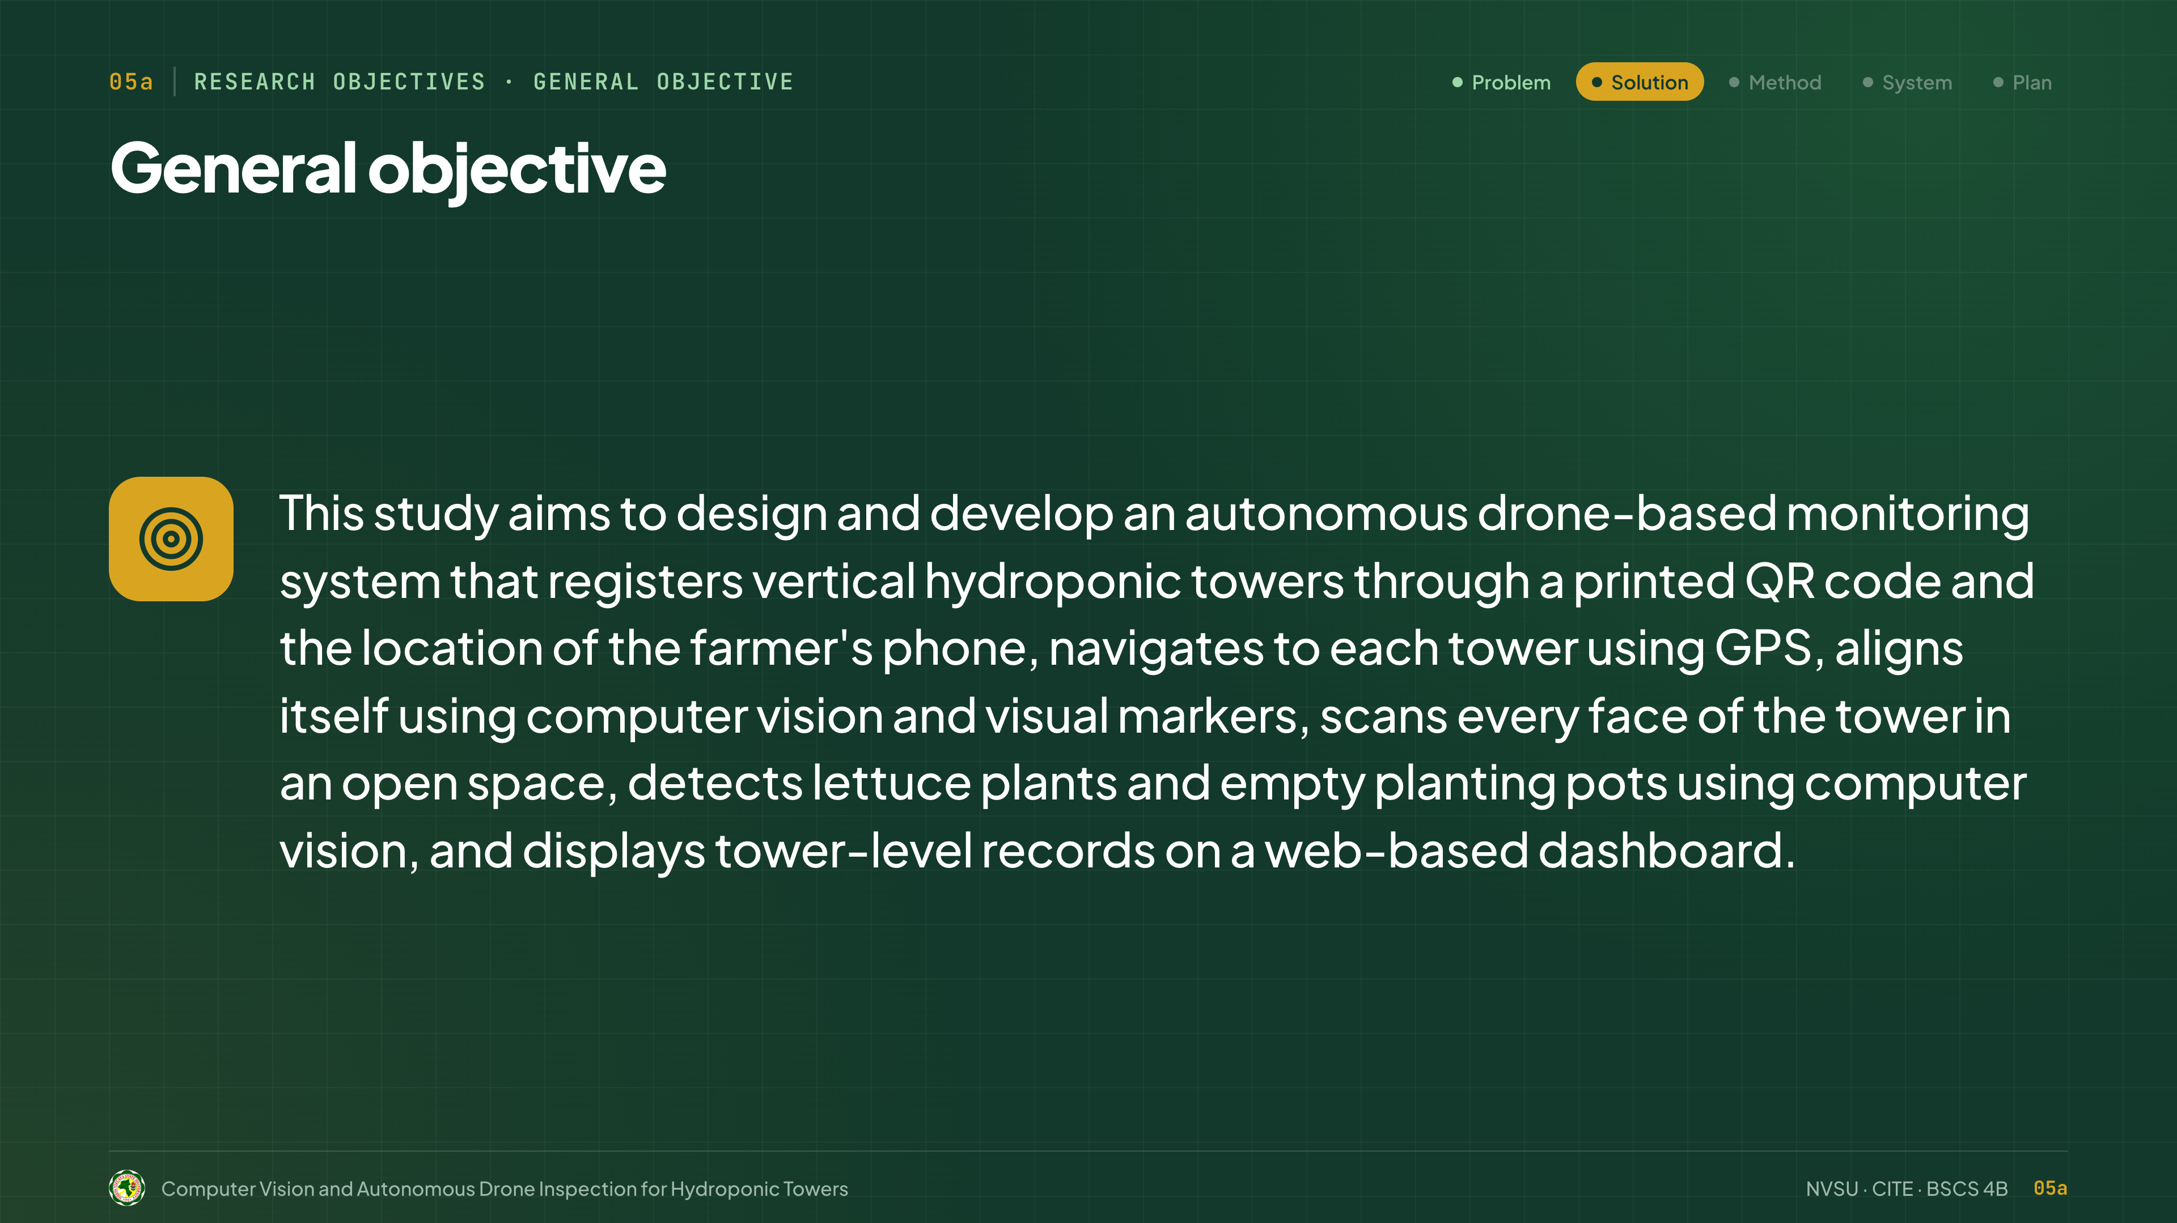
Notes:
Thank you. This study aims to design and develop an autonomous drone-based monitoring system that registers vertical hydroponic towers through a printed QR code and the location of the farmer's phone, navigates to each tower using GPS, aligns itself using computer vision and visual markers, scans every face of the tower in an open space, detects lettuce plants and empty planting pots using computer vision, and displays tower-level records on a web-based dashboard.

Slide 13
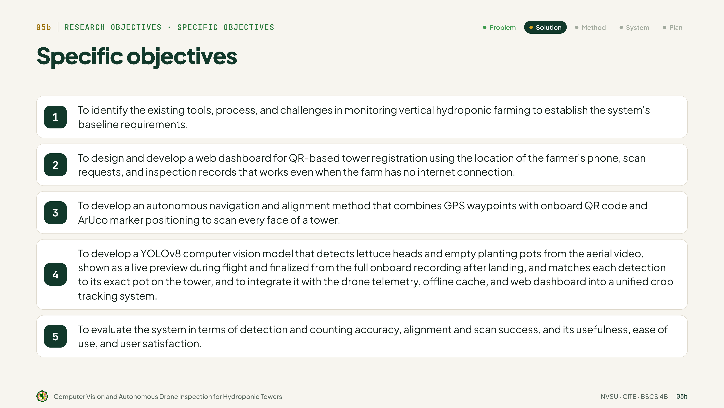
Notes:
The specific objectives of the study are:
1. To identify the existing tools, process, and challenges in monitoring vertical hydroponic farming to establish the system's baseline requirements.
2. To design and develop a web dashboard for QR-based tower registration using the location of the farmer's phone, scan requests, and inspection records that works even when the farm has no internet connection.
3. To develop an autonomous navigation and alignment method that combines GPS waypoints with onboard QR code and ArUco marker positioning to scan every face of a tower.
4. To develop a YOLOv8 computer vision model that detects lettuce heads and empty planting pots from the aerial video, shown as a live preview during flight and finalized from the full onboard recording after landing, and matches each detection to its exact pot on the tower, and to integrate it with the drone telemetry, offline cache, and web dashboard into a unified crop tracking system.
5. To evaluate the system in terms of detection and counting accuracy, alignment and scan success, and its usefulness, ease of use, and user satisfaction.

Slide 14
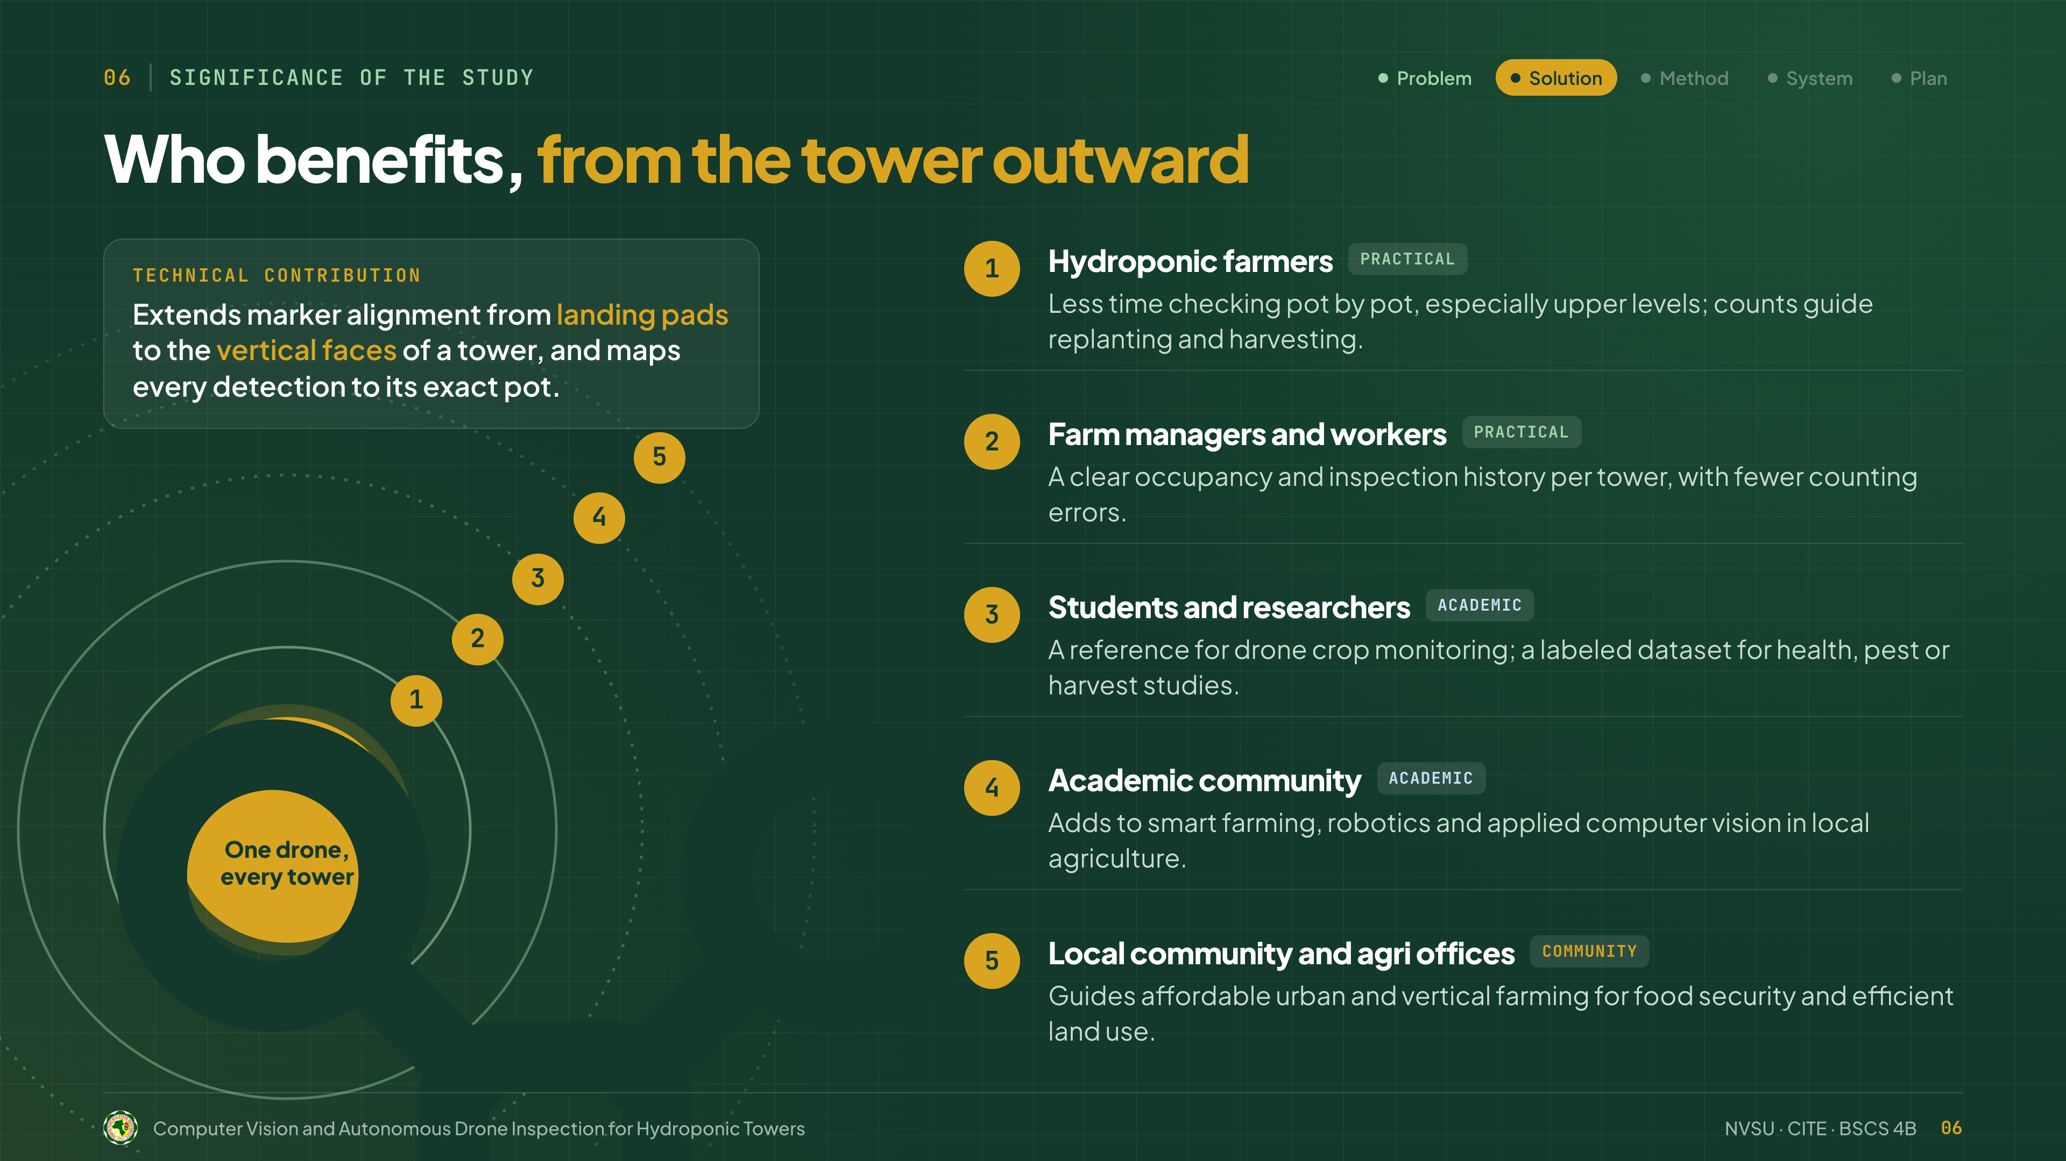
Notes:
Our technical contribution: we extend marker alignment from landing pads to the vertical faces of a tower, and map every detection to its exact pot.
At the center: one drone, every tower. This is beneficial to five groups. Hydroponic farmers, who spend less time checking pot by pot. Farm managers and workers, who get a clear record of every tower. Students and researchers, who get a labeled dataset to reuse. The academic community, through new work in smart farming. And the local community and agri offices, as a guide to affordable vertical farming.

Slide 15
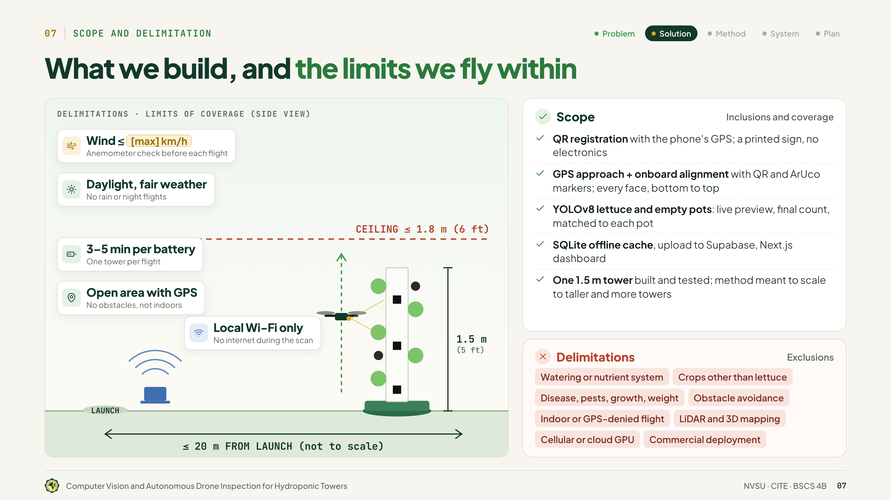
Notes:
Our scope, on the right: QR registration with phone GPS and a printed sign; GPS approach and marker alignment; YOLOv8 counting matched to each pot; an offline cache and dashboard; and one 1.5-meter tower, meant to scale to more towers.
Our limits, on the left: below 1.8 meters, within 20 meters of launch, safe wind, daylight, open area with GPS, one tower per battery, and local Wi-Fi only.
We exclude the watering system, other crops, plant health and weight, obstacle avoidance, indoor flight, LiDAR, cellular or cloud GPU, and commercial deployment.

Slide 16
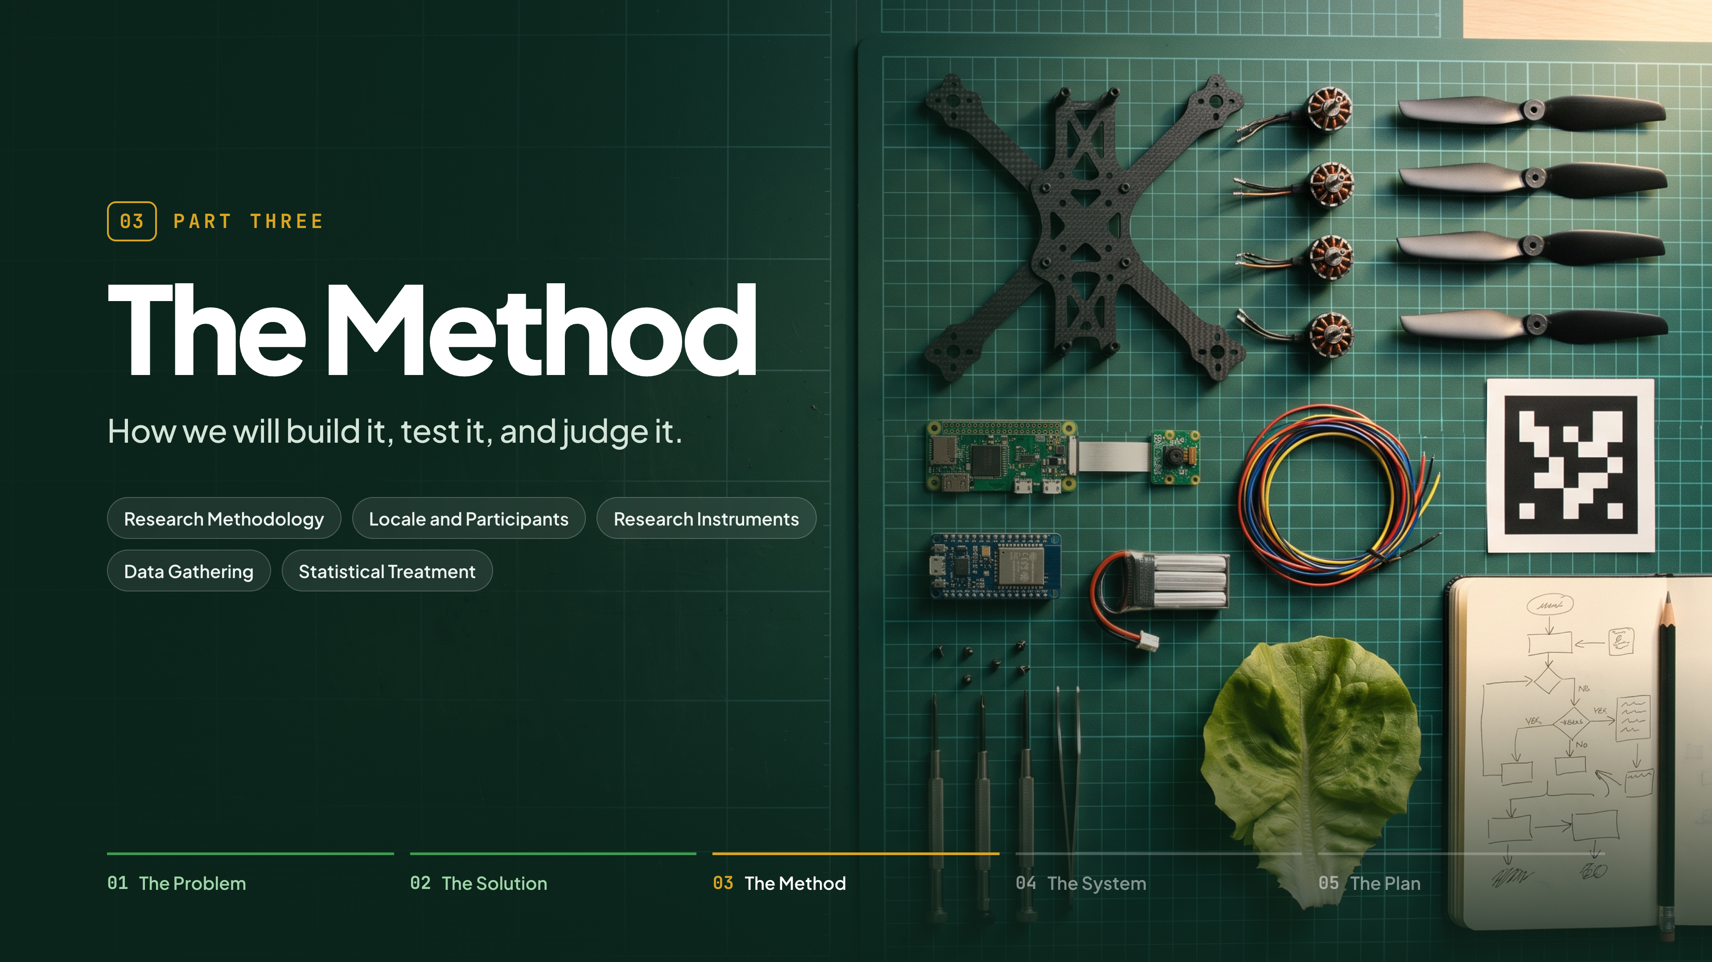
Notes:
(No lines.)

Slide 17
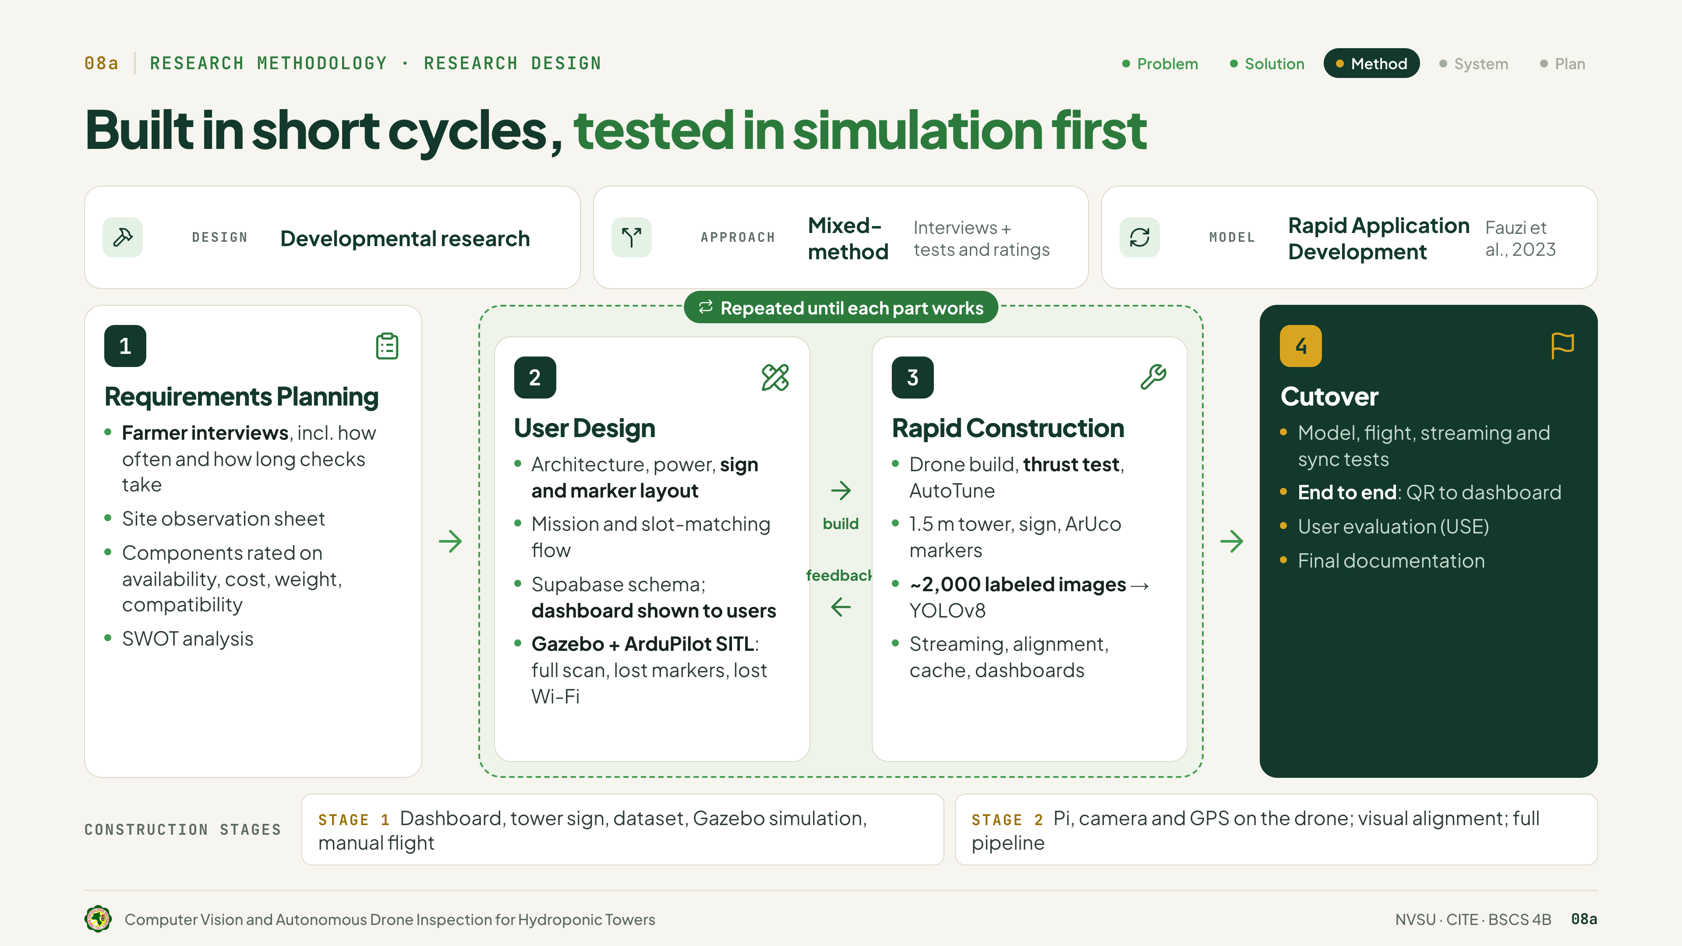
Notes:
Ours is developmental research, with a mixed-method approach, using Rapid Application Development from Fauzi and colleagues.
Phase 1, Requirements Planning: interviews, site observation, choosing components, and a SWOT analysis. Phase 2, User Design: the system design, tested first in Gazebo simulation. Phase 3, Rapid Construction: building everything in two stages, first manual flight, then the Pi, camera and GPS. Phases 2 and 3 repeat until each part works. Phase 4, Cutover: full testing, the USE evaluation, and documentation.

Slide 18
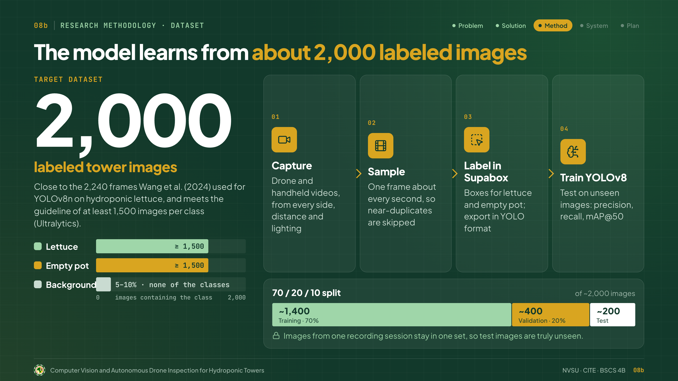
Notes:
Our target is about 2,000 labeled images, close to Wang's 2,240, and meeting the Ultralytics guideline of 1,500 per class: lettuce, empty pots, plus 5 to 10 percent background.
Four steps: capture video from every side, sample a frame per second, label in Supabox, and train YOLOv8. The split is 70, 20, 10, with each recording session kept in one set, so test images are truly unseen.

Slide 19
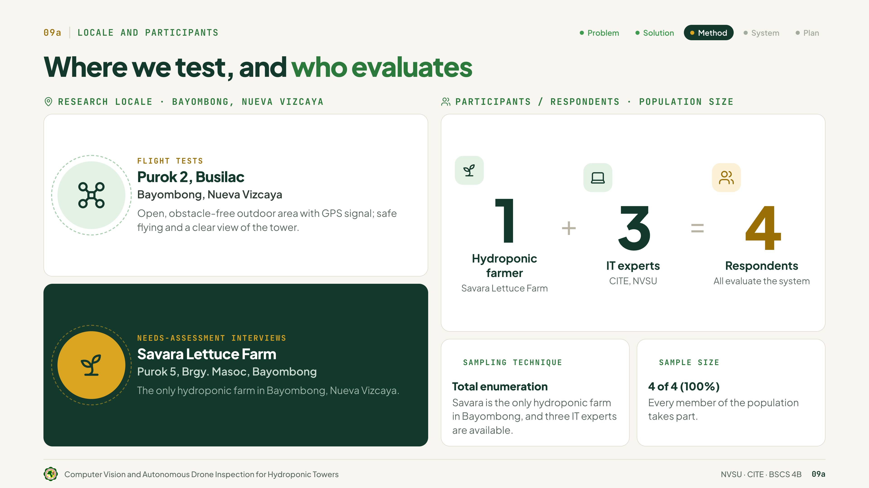
Notes:
Flight tests are at Purok 2, Busilac, an open area with GPS. Interviews are at Savara Lettuce Farm in Masoc, the only hydroponic farm in Bayombong. Our respondents are one Savara farmer plus three IT experts from CITE, NVSU, four in all, and all evaluate the system. We use total enumeration: four of four, 100 percent.

Slide 20
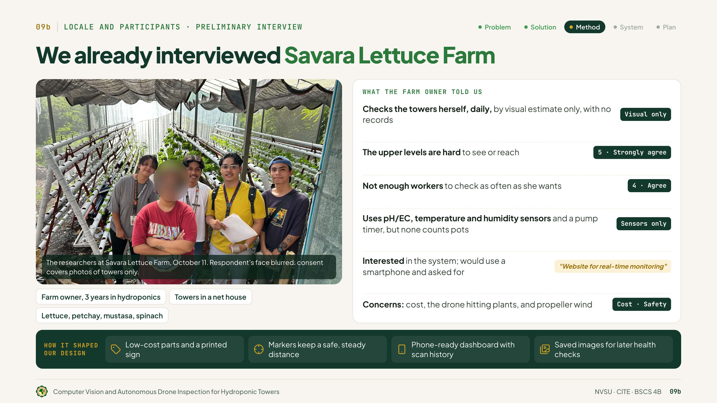
Notes:
We already interviewed Savara Lettuce Farm on October 11. She has three years in hydroponics, with towers in a net house.
She checks the towers herself, daily, by eye, with no records. She strongly agreed the upper levels are hard to reach, and agreed there aren't enough workers. Her sensors don't count pots. She would use our system on her phone and asked for a website, but worries about cost, the drone hitting plants, and propeller wind.
So we use low-cost parts and a printed sign, markers that keep a safe distance, a phone-ready dashboard, and saved images for later health checks.

Slide 21
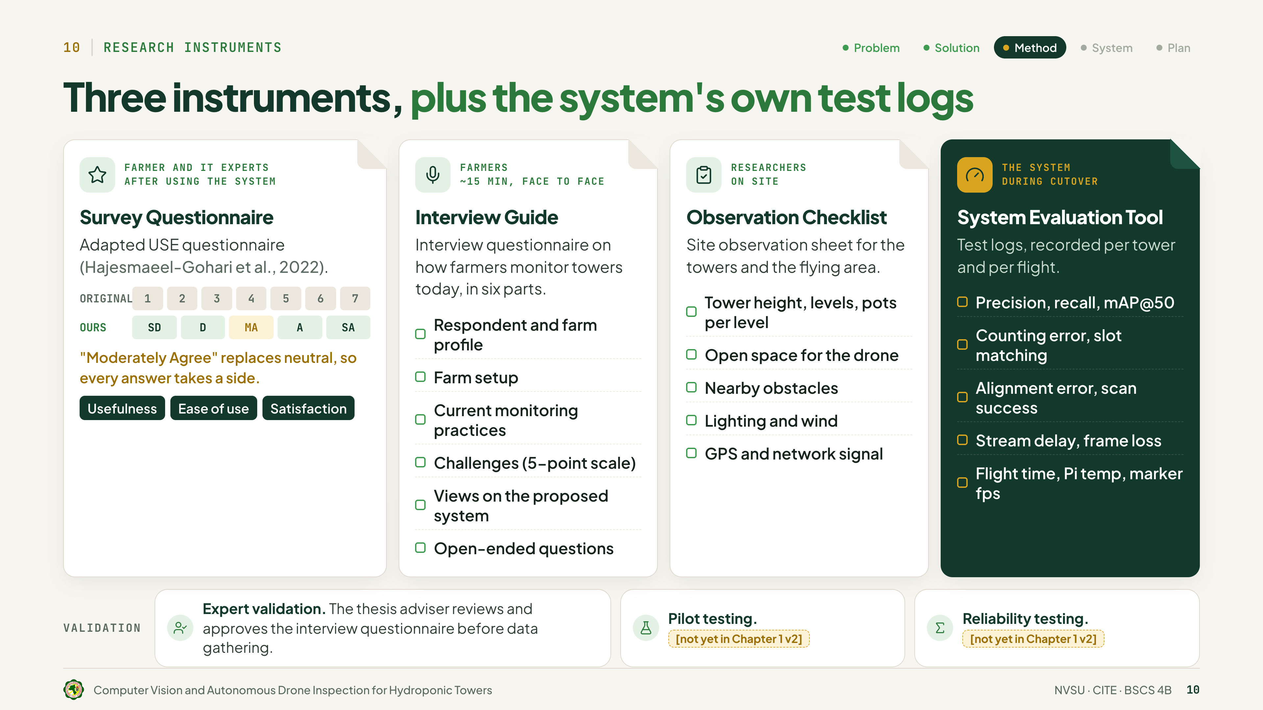
Notes:
We use three instruments, plus the system's test logs. The survey adapts the USE questionnaire from Hajesmaeel-Gohari, for usefulness, ease of use and satisfaction, on a 5-point scale where "moderately agree" replaces neutral. The interview guide has six parts, about 15 minutes face to face. The observation checklist covers the site. And the system evaluation tool logs every flight. Our adviser validates the interview questionnaire. [Pilot and reliability testing: fill in.]

Slide 22
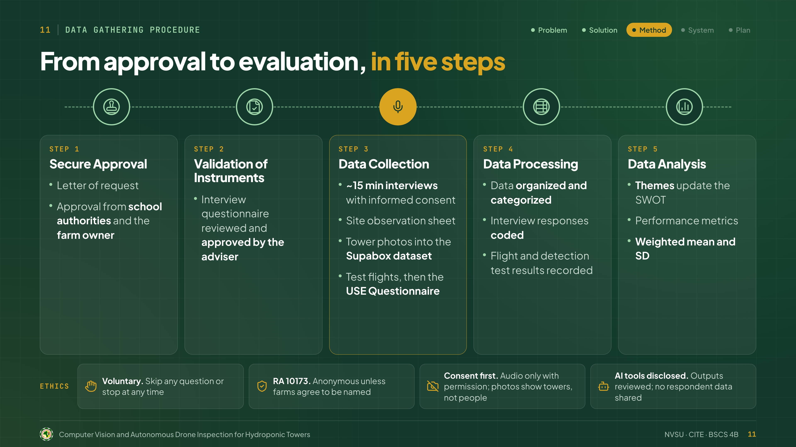
Notes:
Data gathering has five steps.
Step 1, Secure Approval: a letter of request, approved by the school authorities and the farm owner.
Step 2, Validation of Instruments: our adviser reviews and approves the interview questionnaire.
Step 3, Data Collection: 15-minute interviews with informed consent, the site observation sheet, tower photos for our Supabox dataset, then the test flights and the USE questionnaire.
Step 4, Data Processing: we organize the data, code the interview responses, and record the flight and detection results.
Step 5, Data Analysis: the themes update our SWOT, and we compute the performance metrics, weighted mean and SD.
For ethics: participation is voluntary, and respondents can stop anytime. Under RA 10173, farms stay anonymous unless they agree to be named. Consent comes first: audio only with permission, and photos show towers, not people. And AI tools are disclosed, with outputs reviewed and no respondent data shared.

Slide 23
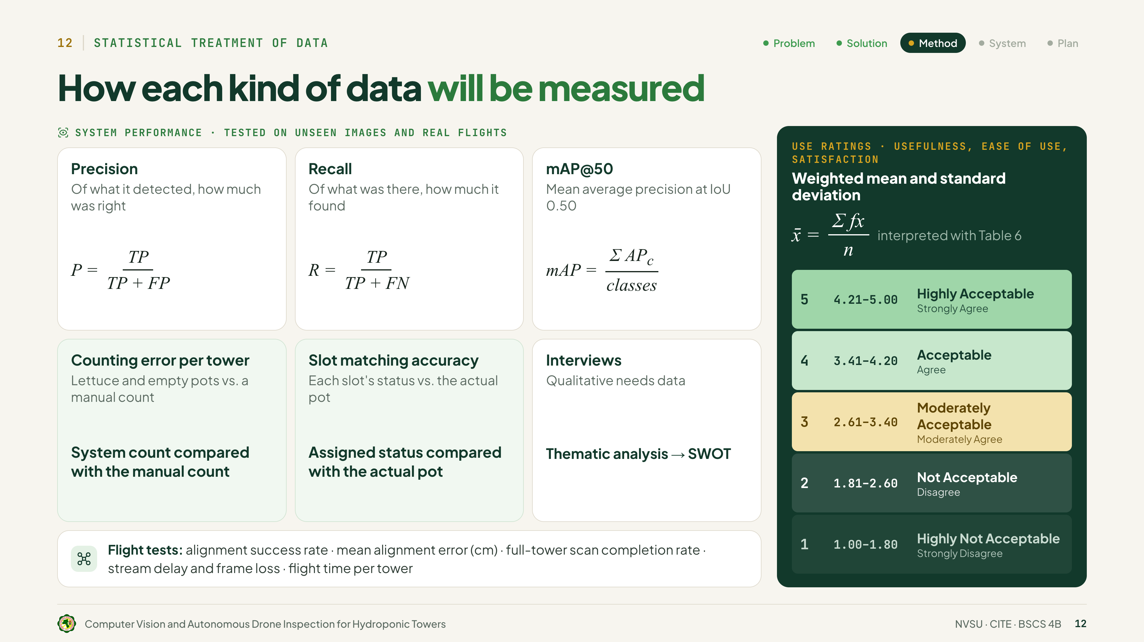
Notes:
We test on unseen images and real flights. Precision: of what it detected, how much was right. Recall: of what was there, how much it found. And mAP@50, the overall score. Counting error and slot matching compare our results with a manual count and the actual pots. Interviews use thematic analysis, and flight tests measure alignment and scan completion.
The USE ratings use the weighted mean and SD, from 4.21 to 5.00, Highly Acceptable, down to 1.00 to 1.80, Highly Not Acceptable.

Slide 24
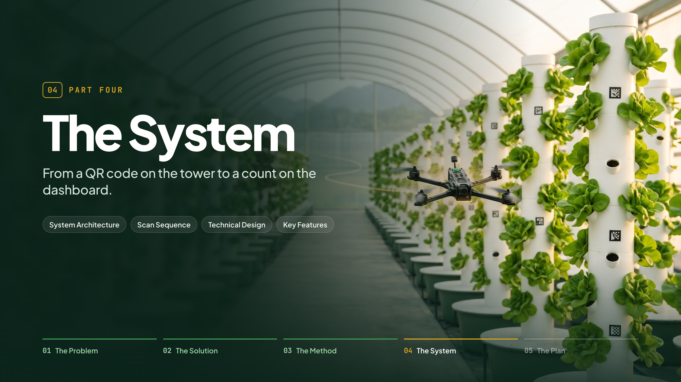
Notes:
(No lines.)

Slide 25
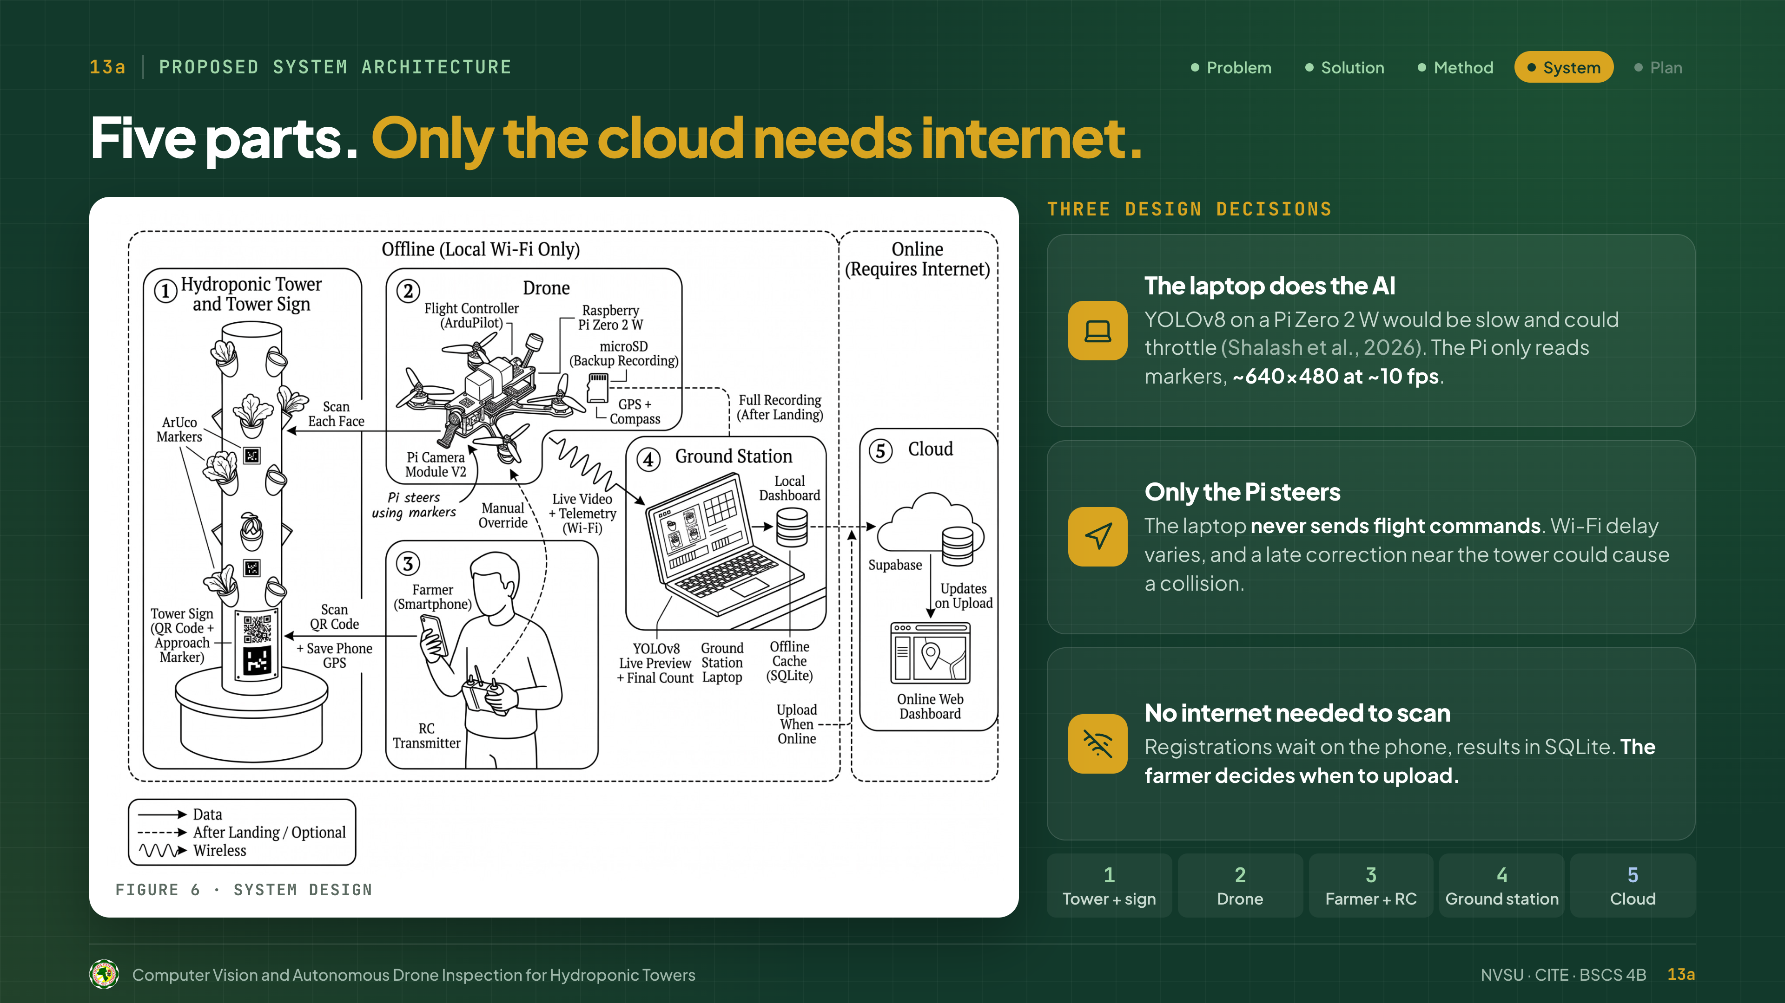
Notes:
Figure 6 has five parts: the tower and sign, the drone, the farmer with the RC, the ground station, and the cloud. Only the cloud needs internet.
Three design decisions. The laptop does the AI, since YOLOv8 on a Pi Zero is slow, as Shalash found. Only the Pi steers, because Wi-Fi delay could cause a late correction and a collision. And no internet is needed to scan: registrations wait on the phone, results in SQLite, and the farmer decides when to upload.

Slide 26
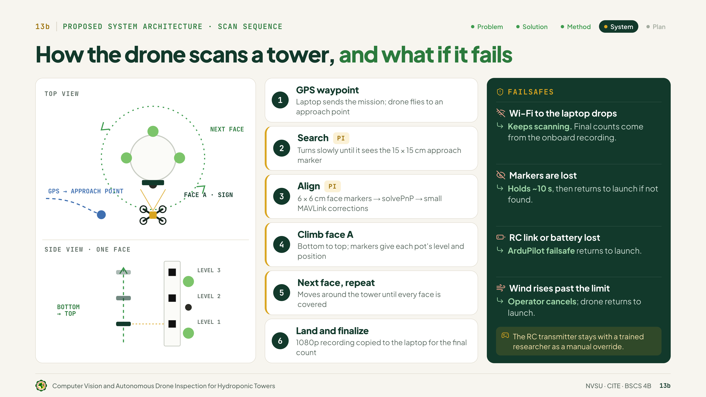
Notes:
This is the scan. One, GPS waypoint to an approach point. Two, search for the 15-centimeter approach marker. Three, align with the 6-centimeter face markers. Four, climb face A, bottom to top, where the markers give each pot's level. Five, next face, repeat. Six, land, and the 1080p recording gives the final count.
Failsafes: if Wi-Fi drops, it keeps scanning. If it loses the markers, RC link or battery, or the wind rises, it returns to launch. And a researcher always holds the RC.

Slide 27
Notes:
Figure 7 shows inside the drone: about 200 to 240 grams, three 3S 650 batteries, and 3 to 5 minutes each. One, power: a separate BEC feeds the Pi, so motor surges can't restart it. Two, flight control: the SpeedyBee on ArduPilot. Three, companion and camera: the Pi Zero talks MAVLink, and the camera records 1080p. Four, ground link: Wi-Fi to the laptop hotspot.
On the bench, we weigh it, test thrust, tune it, and calibrate the camera.

Slide 28
Notes:
Our software, layer by layer: Next.js for the web, Supabase for the cloud, YOLOv8 and SQLite on the laptop, OpenCV on the Pi, ArduPilot for flight [ground control station: fill in], and Supabox and Gazebo to build and test.
The web dashboard registers towers by QR, even offline, with a map, scan requests, history, per-pot results and exports. The local dashboard has Live Scan and the Sync Center. All tools are free and open source.

Slide 29
Notes:
(No lines.)

Slide 30
Notes:
This is our proposed schedule, colored by RAD phase. After the proposal defense on November 3, 2026, come the interviews and instrument validation, then design and construction in repeating cycles, then testing and the user evaluation, and finally documentation and the final defense, over six months.

Slide 31
Notes:
On the left is a sample dashboard, not real results. Tower T-01 shows four faces and four levels: 12 lettuce, 4 empty pots, and 4 of 16 slots available. So farmers get per-tower counts without walking every tower, can plan replanting and harvest, and researchers get a reusable dataset.
Our deliverables: the prototype drone, the tower with its sign and 20 markers, the YOLOv8 model with 2,000 labeled images, the local and web dashboards, and our test results and manuscript.

Slide 32
Notes:
Our hardware budget is ₱25,637 to ₱28,467, and software is free. Most goes to flight hardware, then power and control, then the Pi and camera. The laptop isn't included, since we own it; 1404 motors or a travel router are added only if needed; and each extra tower needs only a sign and markers. [Printing, internet, transportation and miscellaneous: fill in.]

Slide 33
Notes:
Thank you for listening. That is our proposal: one drone that checks every pot on every tower. We welcome your questions, comments and suggestions.

Slide 34
Notes:
(No lines. Show only if the panel asks.)

